Slide 1
IBM University Engagement Project Submission
“Exploring the power agentic AI and IBM Granite”

Slide 2

Project Title – Fitness Buddy: An AI-Powered Personal Fitness & Wellness Coach
Domain of Project – Health, Fitness & Wellness
Student Name | Recent Passport Photo | Email ID | Mobile number [WhatsApp]
L Mahadeva Balan |  | mahadevlakshmanan@gmail.com | 8147197853

Slide 3
Problem Statement – Fitness Buddy
Fitness Buddy – AI Health Coach
The Challenge
Many people find it difficult to maintain a consistent fitness routine because workout guidance, meal suggestions, hydration habits, recovery advice, and motivation are spread across different apps and sources. Generic plans may not match a person's fitness level, goals, available time, equipment, dietary preferences, or lifestyle. Users also need a simple way to ask health and fitness questions and receive guidance that reflects their own profile.
The Objective
Build an AI-powered personal fitness and wellness coach that:
• Collects a user profile and understands goals, fitness level, schedule, equipment, dietary preference, sleep, stress, and motivation style.
• Provides personalized workout routines and meal-plan suggestions.
• Supports motivation, habit-building, hydration, recovery, and progress check-ins.
• Answers fitness and wellness questions using the user's profile as context.
• Accepts uploaded images for AI-assisted analysis.
• Delivers an accessible web-based experience through a conversational interface.

Slide 4
Proposed Solution – Fitness Buddy
AI-Powered Personal Fitness Coach
Fitness Buddy is a web-based AI health coach that creates tailored fitness and wellness guidance from a user's onboarding profile. The application collects personal context such as fitness goals, experience level, weekly availability, session duration, equipment, dietary preferences, health notes, sleep, stress, and preferred motivation style.
The backend is built with Python and Flask. A FitnessBuddy agent manages the user profile and routes requests to focused capabilities such as workout planning, meal planning, motivation, habit tips, progress check-ins, and free-form question answering.
IBM watsonx.ai provides access to the IBM Granite model (ibm/granite-4-h-small) for natural-language generation. Prompt templates combine the user's profile with the selected task. Curated workout plans, meal plans, motivational quotes, and habit tips provide supporting content and fallback responses when the model is unavailable.
The web interface provides a guided seven-step onboarding experience, feature shortcuts, chat interaction, and image upload/analysis. User profiles can be saved and loaded by name.
The result is a personalized digital fitness companion that brings workout, food, lifestyle, and motivation guidance into one application.

Slide 5
Technology Used
Python – Core programming language used to implement the agent logic and backend services.
Flask – Lightweight web framework that serves the application and exposes API endpoints for onboarding, profile retrieval, chat, image analysis, and model status.
IBM watsonx.ai – Provides the hosted foundation-model service and inference integration.
IBM Granite – Model configured in the project: ibm/granite-4-h-small. It generates personalized natural-language responses through the watsonx.ai chat API.
Prompt Engineering – Task-specific prompt templates provide the model with user-profile context for workout plans, meal plans, motivation, habits, progress feedback, and general questions.
Curated Data Modules – Local workout plans, meal-plan suggestions, motivational quotes, and habit tips support recommendations and offline fallback responses.
HTML, CSS & JavaScript – Front-end technologies used for the interactive web interface, onboarding flow, feature controls, chat, and image upload.
Render – Cloud hosting platform used to deploy the live web application.

Slide 6
Application Components Used – Fitness Buddy
1) Web Onboarding Form – Collects the user's basic details, fitness goals, experience level, schedule, equipment, diet preferences, health notes, sleep, stress, and motivation style.
2) Flask Backend – Handles web requests and connects the user interface to the FitnessBuddy agent.
3) FitnessBuddy Agent – Maintains the active user profile and coordinates the application's fitness and wellness features.
4) IBM watsonx.ai / Granite – Uses the configured model ibm/granite-4-h-small to generate context-aware responses.
5) Prompt Templates – Build task-specific instructions using the user's profile and selected feature.
6) Workout & Meal Data Modules – Supply curated workout routines and meal-plan content to support recommendations.
7) Chat & Intent Routing – Routes user messages to workout, meal, motivation, habit, progress check-in, or general Q&A handling.
8) Image Upload & Analysis – Lets users upload an image for AI-assisted analysis through the application's image endpoint.
9) Profile Storage – Saves and retrieves user profiles so returning users can continue with their preferences.

Slide 7
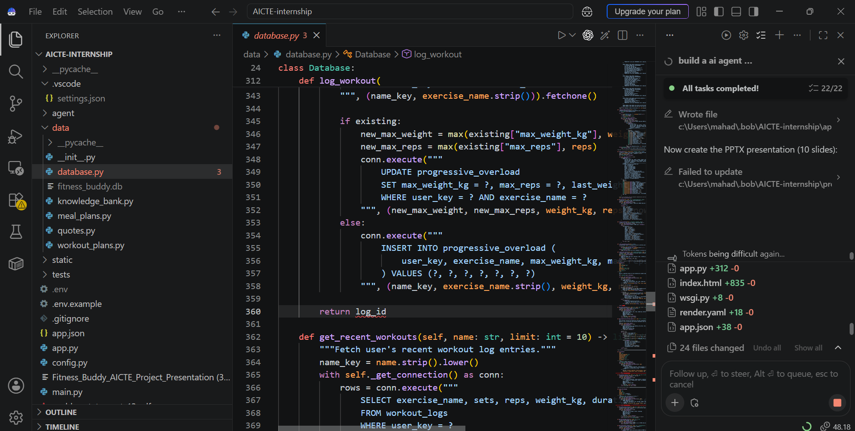
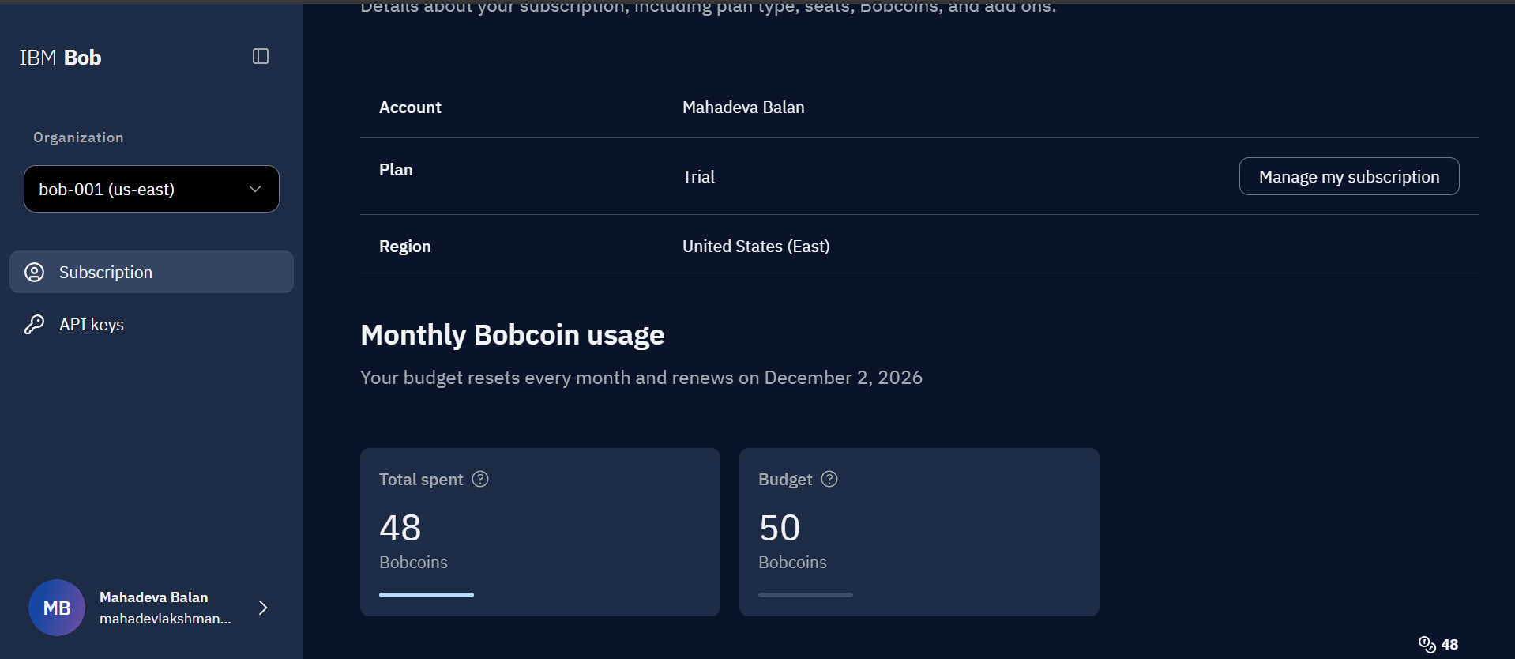
IBM BOB

Slide 8

Role of Agentic AI in Fitness Buddy
Fitness Buddy uses an AI-driven, profile-aware assistant to respond to a user's fitness and wellness needs. Rather than returning the same generic advice to everyone, it uses onboarding information as context for each supported task.
Context Awareness – The agent uses details such as fitness goal, experience level, available time, eq
uipment, dietary preference, sleep, stress, and motivation style to tailor its responses.
Task-Oriented Behaviour – Requests are routed to focused capabilities for workout planning, meal suggestions, motivation, habit-building, progress check-ins, and general questions.
Model-Assisted Generation – Prompt templates combine the selected task with the user's profile and send the context to IBM Granite through watsonx.ai.
Supporting Knowledge – Curated workout, meal, quote, and habit datasets provide structured supporting content and help the application respond when the hosted model is unavailable.
User Interaction – The web interface lets users update their profile, request guidance, chat naturally, and upload an image for analysis.
Note: The current implementation is a profile-aware conversational agent with modular feature handlers; it is not represented as a multi-agent orchestration system.

Slide 9
Novelty and Uniqueness
Fitness Buddy combines personalized fitness planning and everyday wellness support in one AI-powered web application.
Profile-Driven Personalization – Recommendations use a broad onboarding profile, including fitness goals, experience, schedule,
equipment, dietary preference, sleep, stress, and motivation style.
Multiple Wellness Features – Workout planning, meal suggestions, motivation, habit tips, progress check-ins, and general Q&A are available
through one assistant.
Task-Specific Prompting – Separate prompt functions shape responses for the selected feature and provide relevant user context to IBM Granite
Hybrid Response Design – Curated workout and meal data plus motivational content support the AI experience and provide fallback responses
when model access is unavailable.
Multimodal Interaction – Alongside chat, users can upload an image for AI-assisted analysis.
Accessible Web Deployment – A browser-based interface and cloud deployment make the assistant accessible without requiring a local
development setup.
The key value is a unified, adaptable fitness companion that brings personalized exercise, food, and lifestyle guidance into one place.

Slide 10
Project Links & Repository
GitHub Repository:
https://github.com/mahadev2601/AICTE-internship
Live Application:
https://aicte-internship-1dlb.onrender.com/
The public repository contains the application source code and supporting project files. The live application is deployed on Render.

Slide 11
Future Scope
1. Wearable & Fitness Tracker Integration –
Connect smartwatches and fitness bands to use activity, heart-rate, sleep, and workout data as additional
context for personalized recommendations.
2. Progress Dashboard & Analytics –
Add visual tracking for workout consistency, habit completion, hydration, and user-reported progress over time.
3. Advanced Image Understanding –
Improve image-based analysis for food and exercise form, with clear limitations and appropriate safety guidance.
4. Multilingual Voice Assistant –
Enable speech input/output and support for regional languages to make the coach easier to use.
5. Secure User Accounts & Persistent History –
Introduce authenticated accounts, secure profile storage, and longer-term progress history across devices.
6. More Personalization –
Refine recommendations using feedback, changing goals, schedule updates, and user preferences.

Slide 12
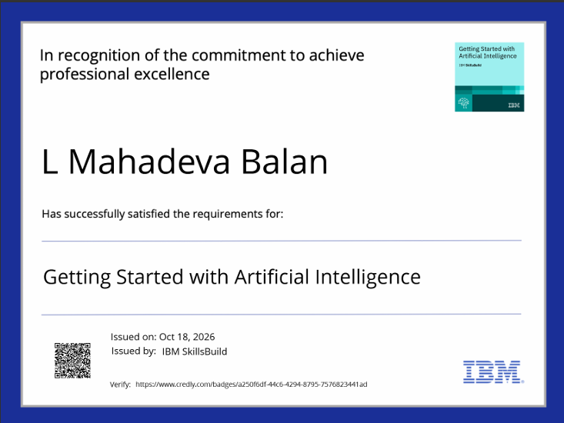
Certificates earned (credly):

Slide 13

Certificates earned (credly):

Slide 14
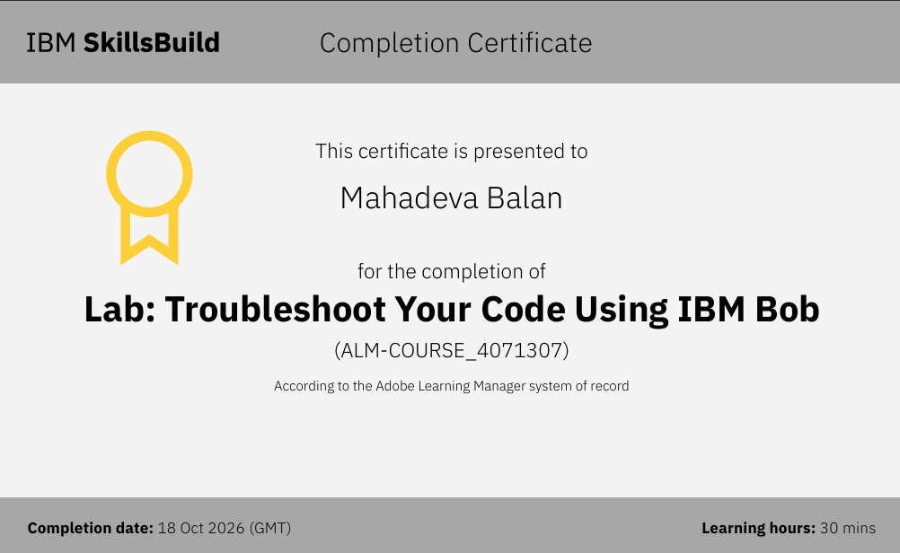
Certificates earned:

Slide 15

Certificates earned:

Slide 16
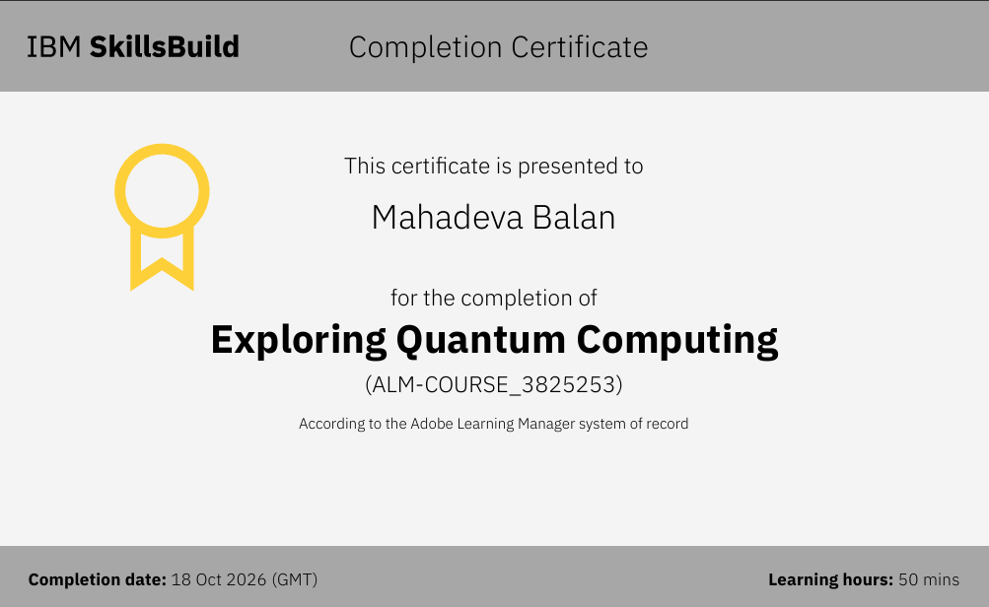
Certificates earned:

Slide 17


